Slide 1


Dare to Dream, Dare to Livestream:
How E-Commerce Livestreaming Empowers Chinese Rural Women
Ningjing Tang, Lei Tao, Bo Wen, Zhicong Lu

Slide 2
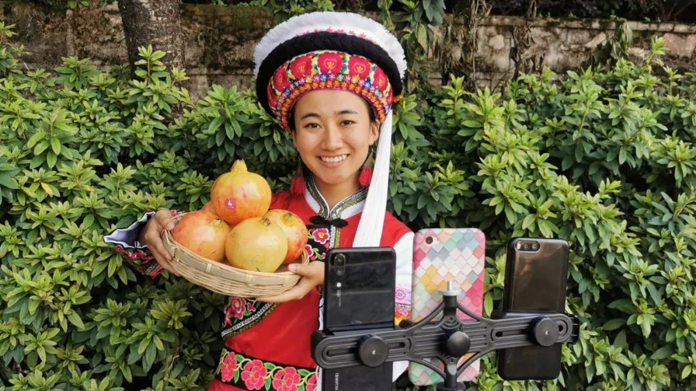
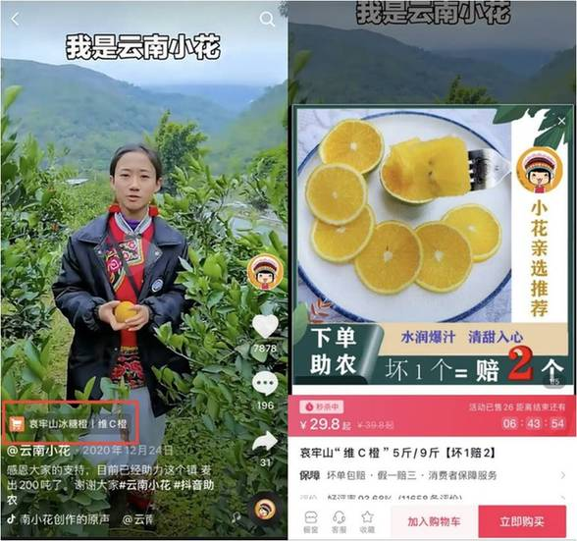


Rural E-commerce Livestreaming in China
Kuaishou
Douyin
Notes:
I would like to first introduce what rural livestreaming is like in China. Take Xiaohua in the picture as an example. She chose to be a livestreamer selling local products in her hometown in Yunnan.
The platform she used is Douyin , the Chinese version of tiktok, and some other streamers also chose to use Taobao or Kuaishou which is a very popular streaming platform. In her streaming she would not only sell a variety of products, but also present her local culture and lifestyle to her audiences.
We noticed that in China, more and more rural women are joining the trend to become a livestreamer.

Slide 3
Unexplored Community – Rural Female Livestreamers
30.4%
of the total Chinese Internet users are rural residents
26.4%
of rural government members are females
Notes:
Meanwhile, however , those rural female livestreamers are rather unexplored inside HCI community, and little HCI work has paid attention to them.
Rural female livestreamers are still often in situations where poverty, a lack of resources, and gender inequality still exist. The urban-rural digital gap is still significant in China, with rural residents accounting for only 30.4% of the total Internet users by June 2020. Also only 26.4% of the rural government members are female.

Slide 4

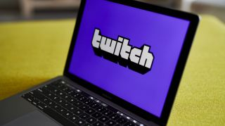
Challenges for Female Streamers
Stigmatized female streamers
Harassment from online users
Using sexual attractiveness
Twitch hate raids
l
Notes:
Also as female streamers, they may encounter stigma and harassment from the internet. Previous HCI
Also, cases called hate raids are reported on twitch, that is, streamers were targeted by a flood of hateful messages, mainly from bot accounts
Although rural female streamers in China may share some similarity with those game streamers on western platforms, the stigma they may face is, we believe, very different from their western counterparts. They may face stigma directly from local communities and the rural society.

Slide 5
RESEARCH QUESTIONS
Motivations
Challenges
Resourse
Market
Empowerment
Seamlessly evisculate critical
services customer directed scenarios.
Seamlessly evisculate critical
services customer directed scenarios.
What are the motivations behind rural women who participate in E-commerce livestreaming?
What kind of social stigma and challenges do they encounter and how do they combat them?
”
How does E-commerce livestreaming impact the wellbeing of rural female streamers?
Notes:
Therefore, our study aims to answer the three questions, we want to understand why they choose to be a livestreamer, what challenges and social stigma they encountered, and how the career impacts on their wellbeing.

Slide 6
Methods
Observation of the streaming videos
Semi-structured interview with 9 participants
Ages between
No. of followers between
Platforms
29 - 38
1.9k – 375k
Douyin, Taobao, Toutiao
Notes:
To get answers for the questions, we conducted a qualitative research through semi-structured interviews and observations from the streamers’ streaming videos.
We recruited 9 participants from different platforms on the internet.
As the talk has limited time, we would only introduce some important findings we want to emphasize here.
# aggregate data

Slide 7
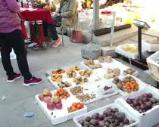
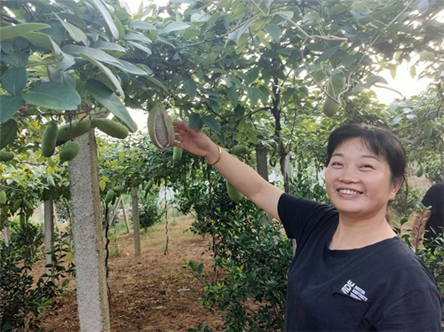
Findings
Streaming Content and Formats
Market or Bazaar Livestreaming
Orchard or Farm Livestreaming
Notes:
The first part of our findings is, From our observation of the streamings, we categorized some different streaming contents.
Some streamers may go to local markets and act like a purchase agent _ that is, their viewers will pick what they want in the market and the streamer will buy for them.
Some other streamers may livestream in their orchard or farm to show their products’ high quality.
# 图片

Slide 8
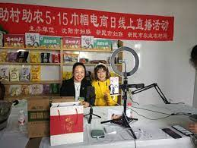
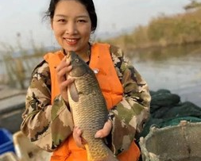
Findings
Streaming Content and Formats
Livestreaming Indoors
Livestreaming in the wild
Notes:
Some would livestream in their home. Typically they would sell agricultural products or dried products such as deer antlers, and sometimes they show how to cook with their products in front of the camera.
While Some others would livestream in the wild. The picture on the right shows a streamer who livestreams her fishing in the local lake.
# 左边图片

Slide 9
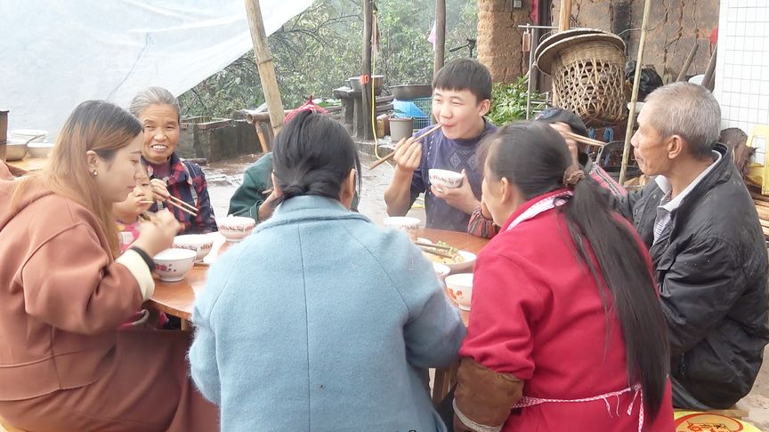
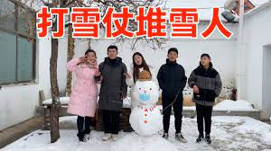
Findings
A Special Streaming Mode: Family Business
Stream with family members
Show family gatherings to audiences
Notes:
We also observed an interstesting mode, we call it the “family business”. Typically streamers with this streaming mode would stream with her families, and also present family gatherings and special events to her audiences. The picture on the left is showing a family gathering and eating together, and the picture on the right is showing a family together building a snowman.

Slide 10
Findings
Motivations: Give Care to Family
Female family members’ responsibilities
Care for both the children and the elderly
“Both my husband and I were migrant workers in the city, but after my pregnancy, I couldn’t continue my work, so I came back home.”
(P8 from Henan, aged 30)
“I could only visit my parents a few times a year when I was a migrant worker, but after I came back home and took the job, I could stay with my family every day. ”
(P7 from Jilin, aged 29)
Notes:
many of our interviewees mentioned that the job let them both earn money and give care for the children or the elderly. The job’s flexibility gives them a chance to balance work and family compared with other jobs like migrant workers in the city.
# participant/age/地区/平台 加上context

Slide 11
Findings
Behind the “Family Business”
Technical support and logistics
“I think I can barely do anything. It all thanks to my husband. He used to learn advertising design and he knows a lot.” (P7 who shared her business with husband) only visit
Y
→ Male chauvinism embedded in family streaming
Dependent on husband’s technical skill
Lack of self-confidence
Marketing
Notes:
Apart from the motivation related to their gender role, as we have mentioned before, we noticed that many female streamer would choose to stream with their husband, and it increases their confidence to start their livestreaming career and handle challenges. P7’s quote is an example, she credited the success of her streaming career to her husband:
I think I can barely。。。
The mode of family business indicates that the male chauvinism is still embedded in family streaming, and these livestreamers were mostly dependent on their husband’s or relative’s technical skills.

Slide 12
Findings
Stigma from Gender Identity
Livestreamers are considered as “strip livestreamers” in rural areas
Gossips from the local community: “[P4’s husband name]’s wife is facing the smart phone all the time. She must be hooking up with boys online”
Endorsements from the local government are important for them to mitigate social stigmas
“... I said, I don’t need any other help except a certificate that I didn’t hook up with men on Taobao. I just want you to write on the paper that [P4’s name]’s livestreaming is formal, and I feel safe if I have the government seal on it.”
Notes:
The observation of family business also led us to dig deeper into the challenges those streamers may face in a rural society. One of our participant told us about how the rumors in her village saying she was hooking up with boys online. She noted that in the village where she resided, “only one out of ten people has heard of Taobao” and many of the villagers’ imaginations of female
livestreamers came from “strip livestreamers” on Kuaishou. She then came to the local government asking for an endorsement, because local government is trusted in her village and she believed that with a “government seal” she could prove that her streaming is formal.
However, to her disappointment, the officer did not even know what Taobao is. She was very upset and stop livestreaming for a while.
From her case we could see how female streamers are stigmatized as using her sexual attractiveness to attract viewers within rural communities. Moreover, when they turn to local government for help, the local system could not provide sufficient support for them. Such situation implicates that we need to carefully design both ‘online’ empowerment and local, offline support systems to help those streamers combat the stigma.

Slide 13
Findings
Livestreaming Empowerment
Rural women can be involved at work, and get financial support
“In the past 7 years I have been taking care of my children at home. It’s a matter of standing by 24 hours a day, and it’s sometimes very annoying. But I feel like I suddenly found a sense of belonging since I started the job. I am suddenly energetic. Your goal is very dazed when you just look after your children every day, but the goal becomes clear when you have a career.”
(P7, aged 29, chose to be a livestreamer after 7 years of being housewife)
The feeling of self-employment is satisfying
“The benefit of being a livestreamer is that you can say that you are a boss. If you do it yourself, it is very fulfilling and it also realizes the value of your own life. [Other jobs] are just that you are employed by others, you won’t try so hard”
(P9 from Hubei, aged 34)
Notes:
Despite the challenges they face, from our interviews we found out that the career as a livestreamer impact our interviewees’ well-being in a positive way. Due to their
livestreaming, these women were more involved at work, increased their income and gained spiritual support in their everyday lives as housewives.
Take the quotes from our participants as examples.

Slide 14
Findings
Livestreaming Empowerment
It expands their living circles
The streamers build close connections with viewers and “learn from them”;
The streamers get to know their urban fans, which could potentially bridge rural and urban communities.
It can help them with their personal development
“At first I feel awkward in front of the camera, but then after practice and learning, I gained experience and could talk and chat with the audiences naturally”
(P1 from Shanxi, aged 29)
“My fans will teach me simple words to help me better express myself during the livestreams”
(P4 from Qinghai, aged 38)
Notes:
By building relationships with viewers and customers, they also expanded their living circles and received social support from online communities. They further increased their self-identity and literacy through livestreaming. A participant noted that, at first she felt awkward in front of the camera, but….

Slide 15
Discussion
A Family’s Role in Rural Female Livestreaming
Family as a source of support and motivation
Family as an invisible boundary and restriction
Social Stigmas Related to Livestreaming within Rural Communities
Support from online viewers
Stigma from local community
Not strong enough for streamers to combat stigma
Streamers are lack of local support
Notes:
From our findings we want to further discuss how family plays a role in rural female’s live streaming career.
As we mentioned before , family act as an important motivation for the streamers to choose and continue their career. But on the other side, we also witnessed some rural female livestreamers are still confined by their family’s moral boundaries and even subject male chauvinism. They highly rely on their families on their using of the technology and dealing with business issues, and they must carefully craft their online self-image to satisfy their family’s or husband’s expectations. This echoes previous HCI works on the complex dynamics around female technology users and her family members.
When we investigated into the social stigma our participants faced, we found out a tension emerged between social bonds in the cyberspace and the physical space.
Although they have gained enough online support from fans, they might still be discouraged if the stigmas remained in the local community.

Slide 16
Design Implications
Address Stigmas and Provide Career Support
Local stakeholders must be involved.
LOCAL GOVERNMENTS
PLATFORMS
Host events like workshops to promote
the benefit of livestreaming
Increase rural streaming videos’ visibility
NGOs
Provide resources like courses to train streaming skills
Notes:
we call for platforms and local stakeholders to be more involved, address stigmas and provide career support for female streamers. Local governments can host more events such as workshops to enable more conservative people to understand the power and benefits of livestreaming, so that they could become more open to such careers.

Slide 17

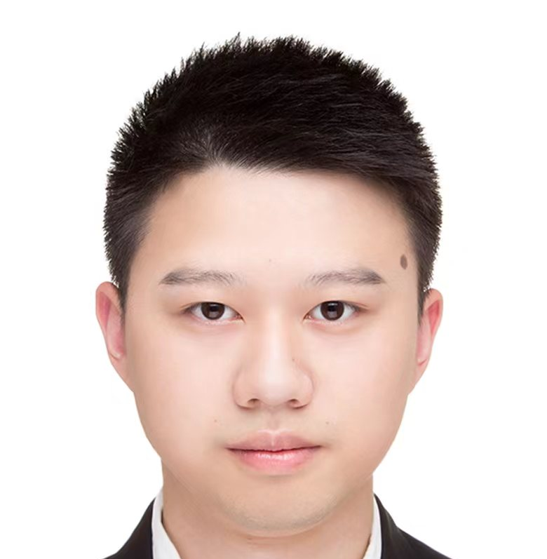



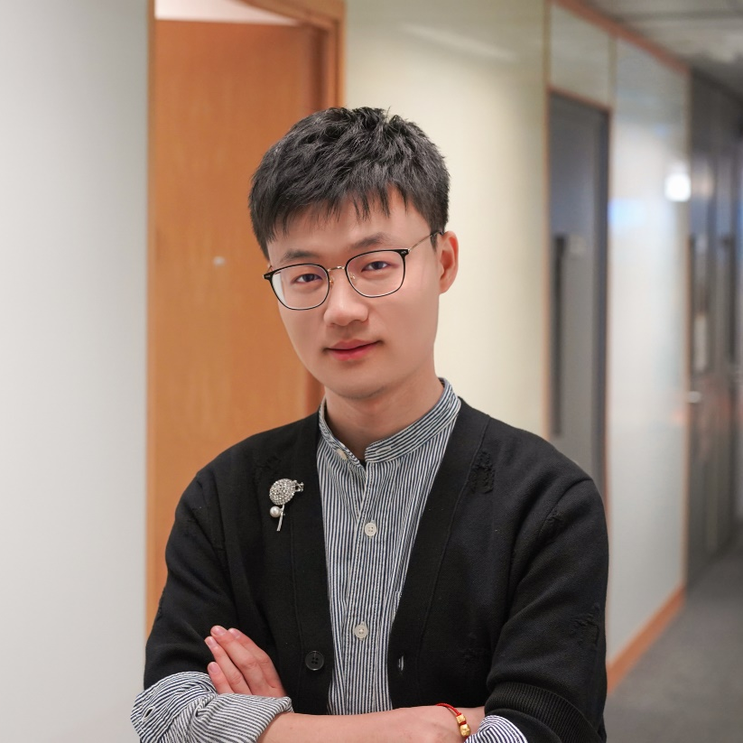
Taking better care of the family;
Seeking self-independence;
Still facing stigmas.
Ningjing Tang
Lei Tao
Tsinghua University
City University of Hong Kong
@EvaaaaaTang
Thank you for listening!
Bo Wen
Zhicong Lu
City University of Hong Kong
City University of Hong Kong
@ilovebowen
@luzc08
Notes:
There are a lot more efforts we could make to empower them .

